Slide 1



Investigating Central Pit Craters in the Northern Hemisphere of Mercury
By: Curtis Dankof
Mentor: Dr. Nadine Barlow
Northern Arizona University

Slide 2
Central Pit Craters
A crater which contains a central depression
  Floor Pit- directly on the floor
  Summit Pit- on central rise/peak

Slide 3
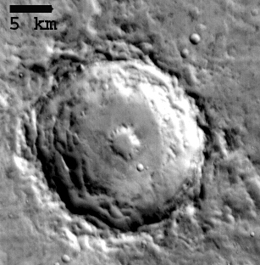
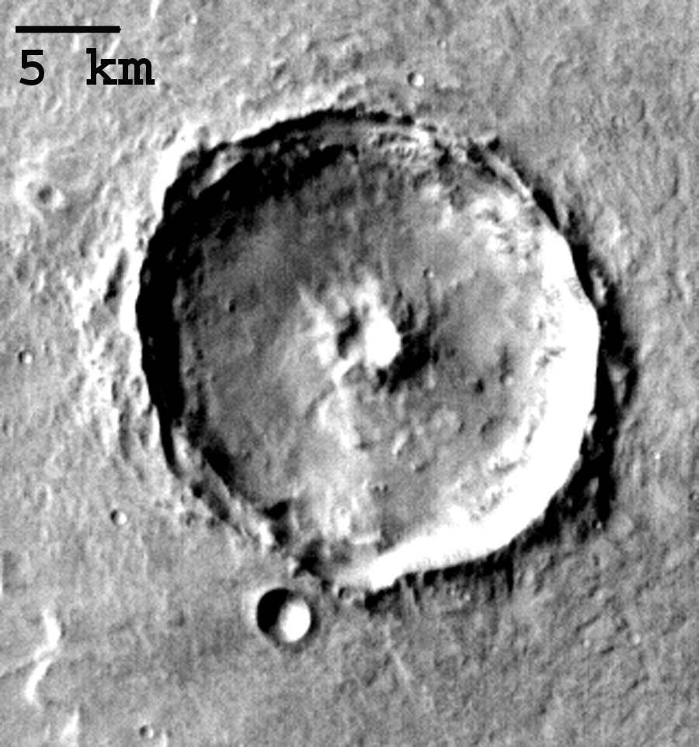
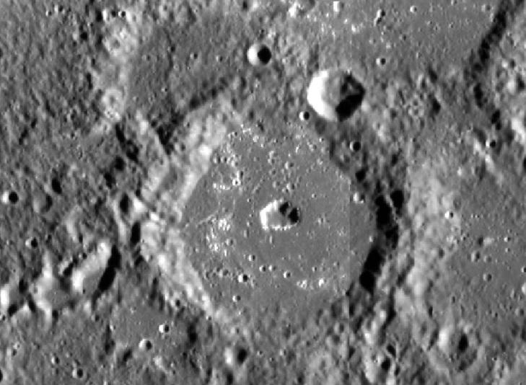
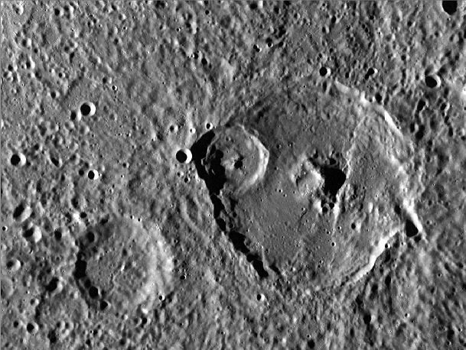
Mars
Mercury Floor Pit Summit Pit
10 km

Slide 4
Formation
Impact-induced vaporization of subsurface volatiles
(Wood et al., 1978)
Excavation into weaker (possibly liquid) subsurface layers
(Croft, 1983)
Collapse of material weakened/brecciated during crater formation (Croft, 1981)
Collapse of central peak in weak targets
(Greeley et al., 1982)
Drainage of melt into sub-floor fractures
(Senft and Stewart, 2011; Bray et al., 2012; Elder et al., 2012)
Mercury is volatile-poor

Slide 5
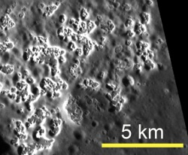
Volcanism/Gas Release
Collapse of magma chambers
  Volcanic past
Release of gaseous material
  Sulfur vaporizing on surface
  Recent formations

Slide 6
Project Objectives
Objective is to compare to outer bodies
  Mars, Ganymede, Callisto
Similarities in formation?
New mechanism altogether?

Slide 7
Geographical Distribution
  Prevalence
    Geographical region
    Elevation
    Latitude/Longitude
  Geologic Unit
  Insight into composition of Mercury

Slide 8

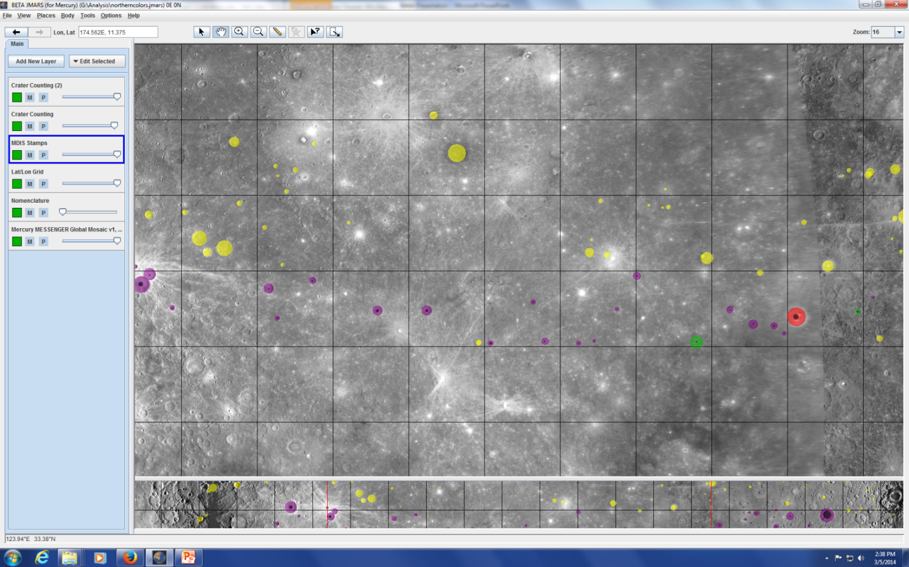
JMARS Program
Utilized the JMARS Program
  3-point routine

Slide 9
Data
Mercury Dual Imaging System (MDIS) from MESSENGER
Crater diameter > 5km

Slide 10
Acknowledgements
Thank you to:
Dr. Nadine Barlow
Kathleen Stigmon
NAU/NASA Space Grant
ASU for JMARS
MESSENGER Team
Arizona Space Grant Consortium

